Slide 1

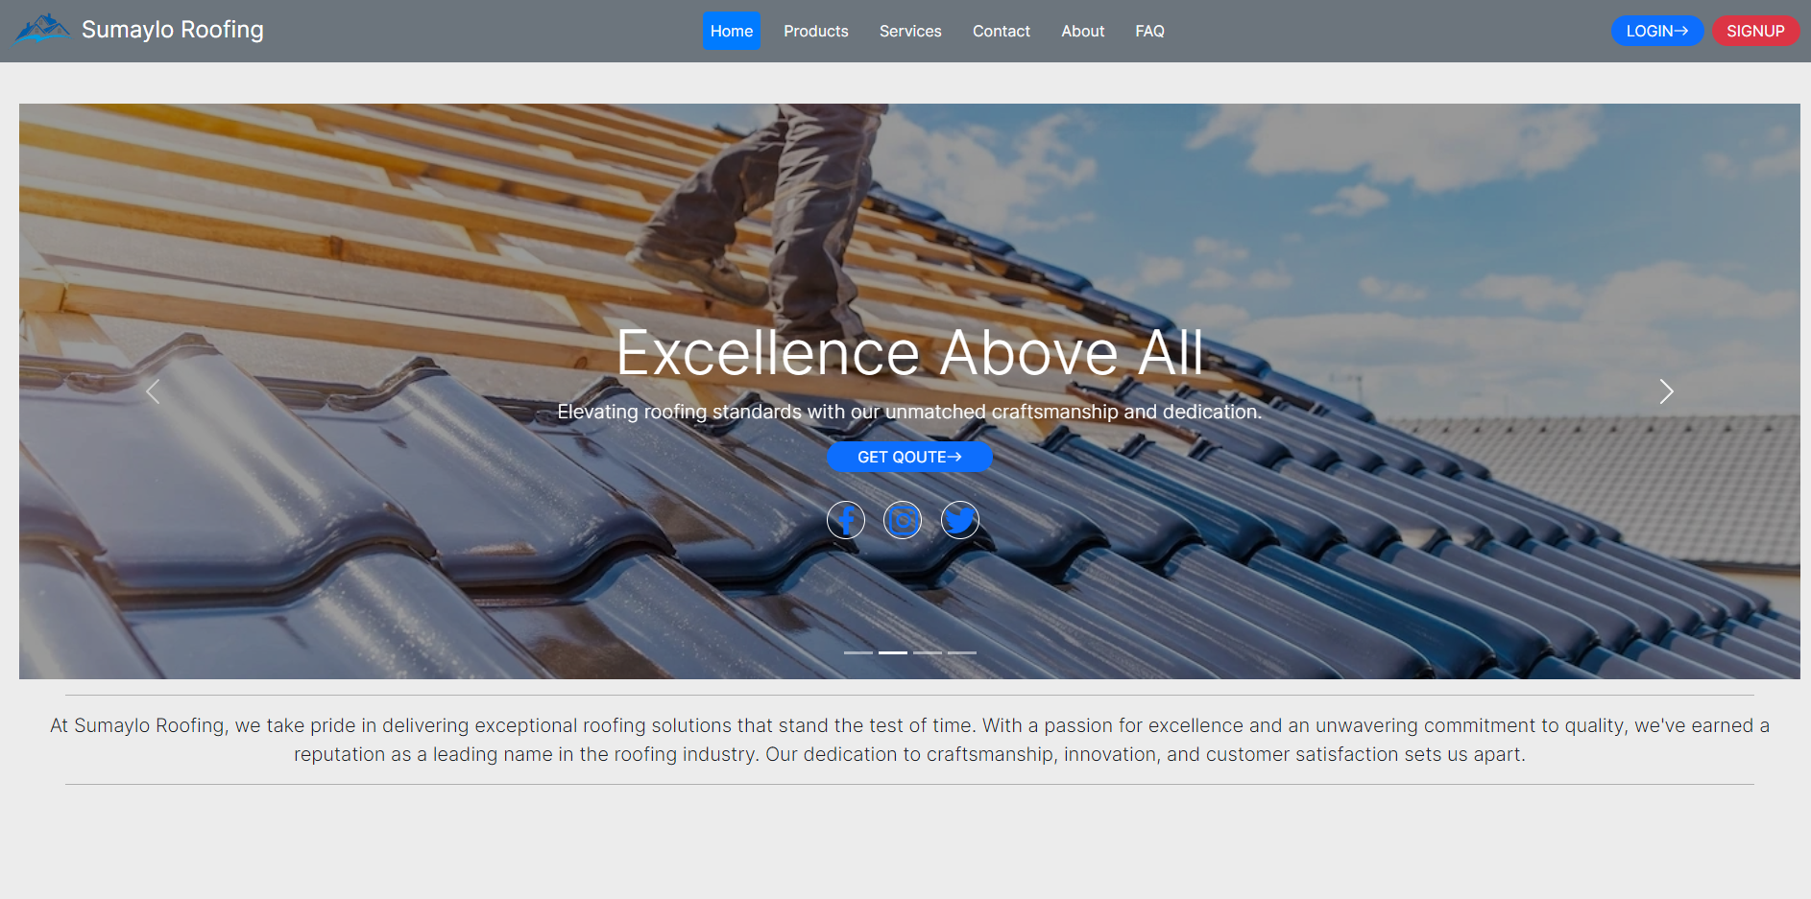
SUMAYLO ROOFING

Slide 2
Project Overview
Sumaylo Roofing is a roofing provider in Surigao Del Norte , and Siargao Island. The Website’s sole purpose is to showcase the work
that they have done, provide a way to contact Sumaylo Roofing for possible service work and show the list of products available.

Slide 3
LANDING PAGE

Slide 4
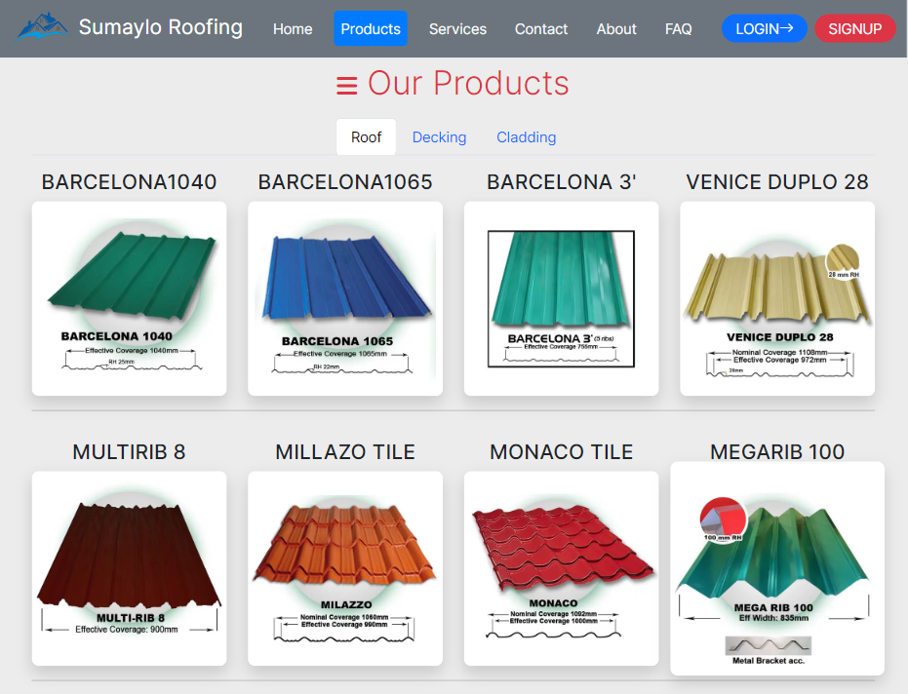
Products Section
Ribtype Roof
Tilespan Roof
Steel Deck
Wall Cladding

Slide 5
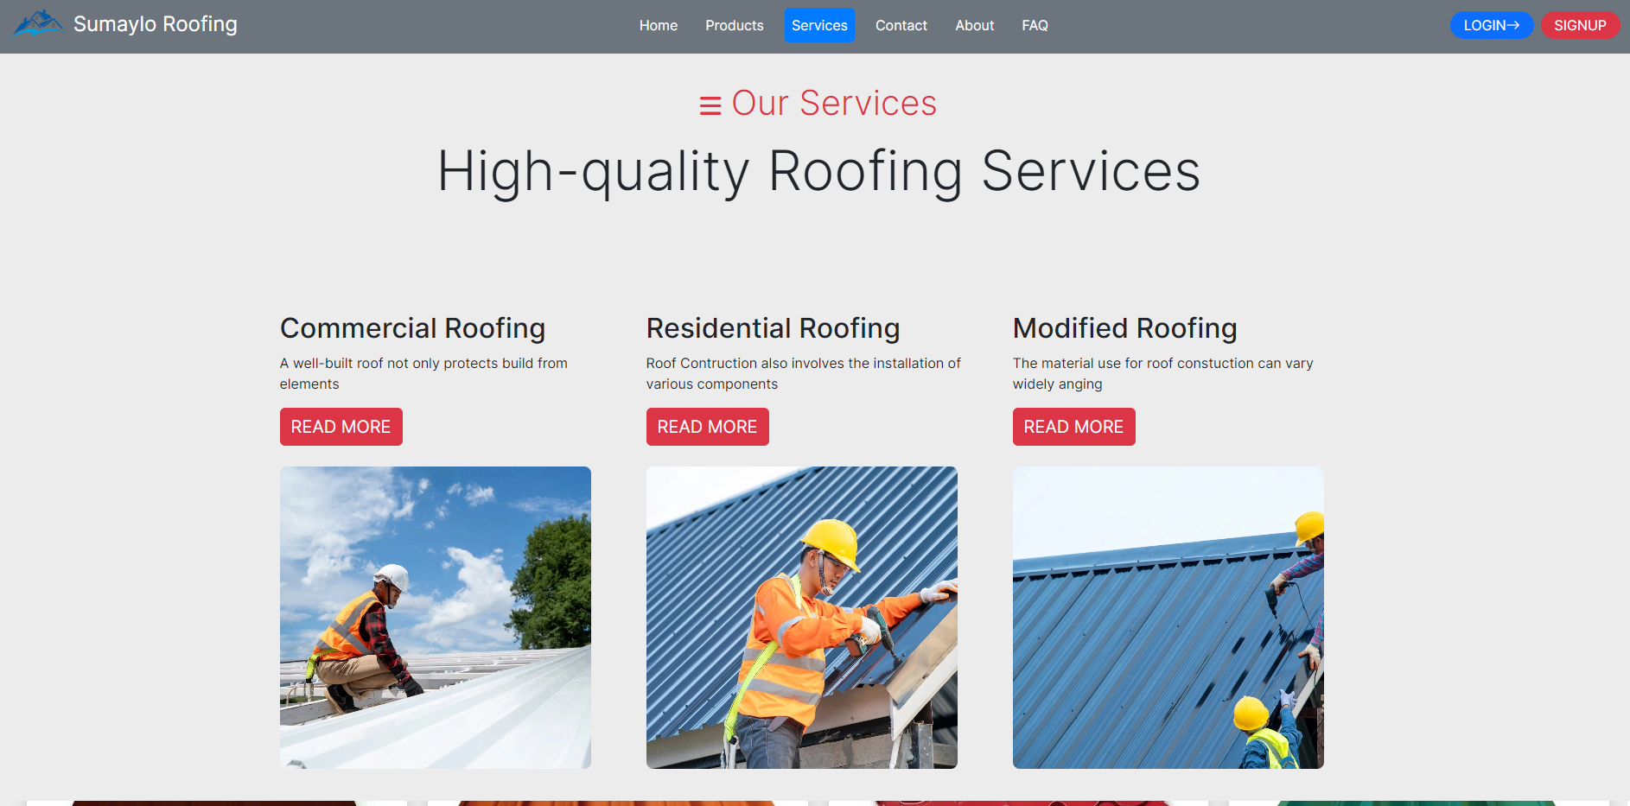
Services Offered
Commercial Roofing
Residential Roofing
Modified Roofing 1. Roof Repair 2. Roof Replacement 3. Roof Inspection

Slide 6
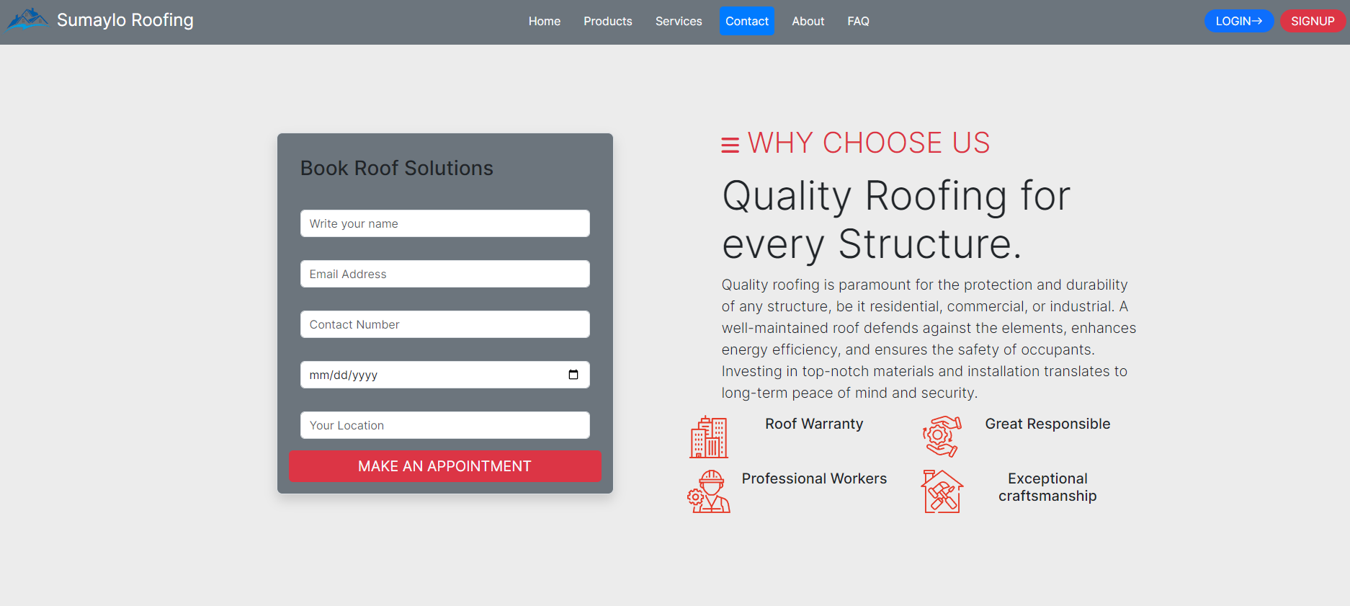
Contact Section
Allow user to input information and ask for site inspection

Slide 7
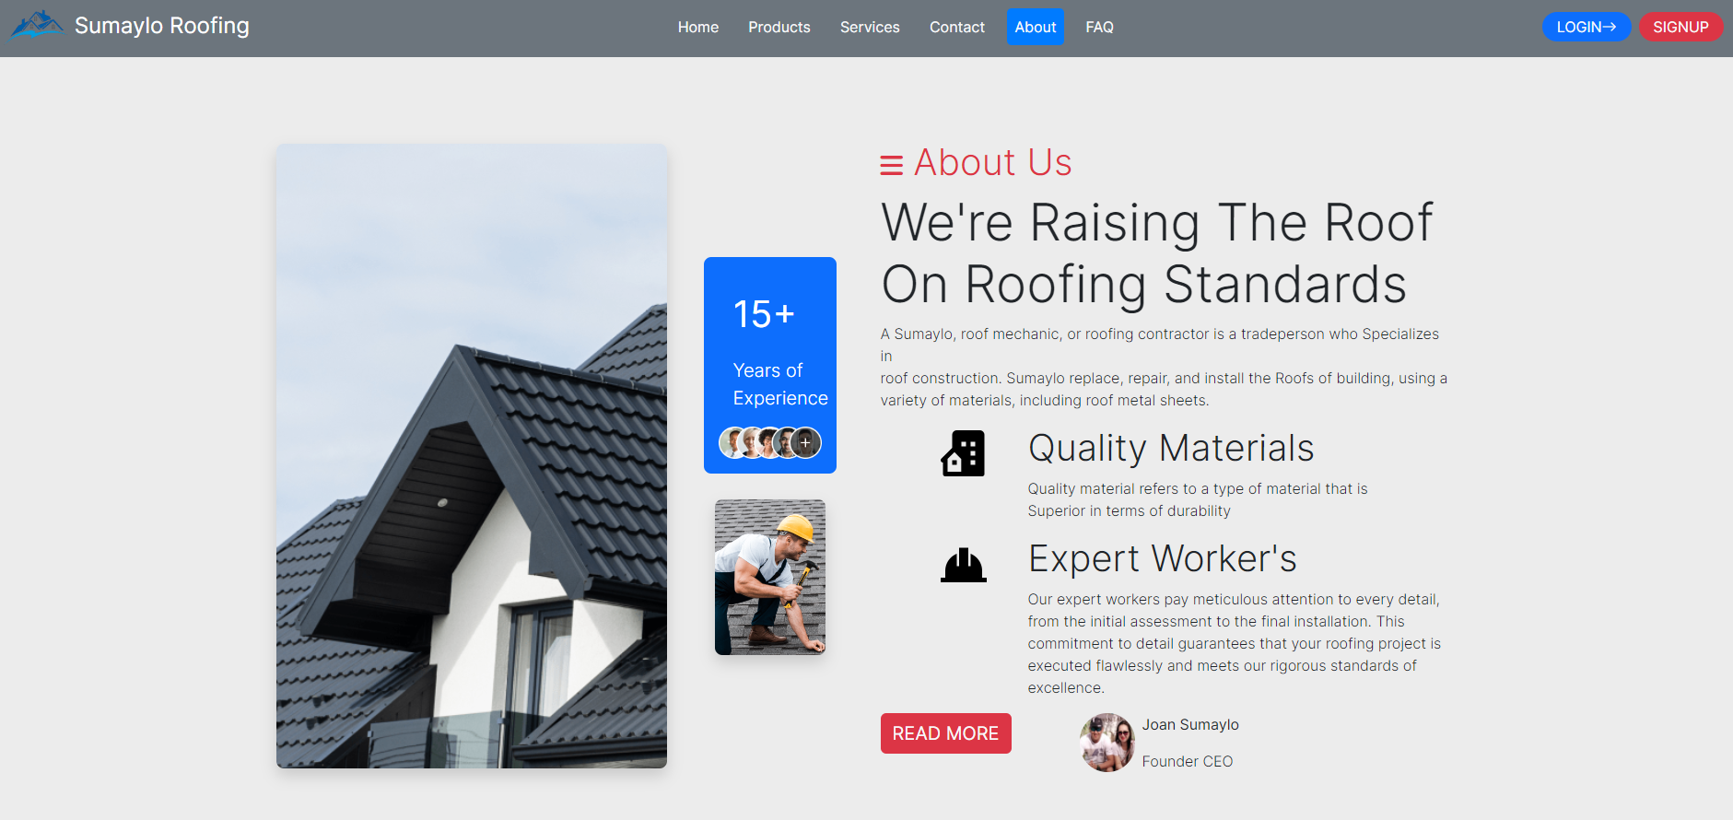
Benefits of Sumaylo Roofing Services
High-quality materials used
Experienced and Professionals Workers
Exceptional Craftsmanship
Roof Warranty
Installation Warranty

Slide 8
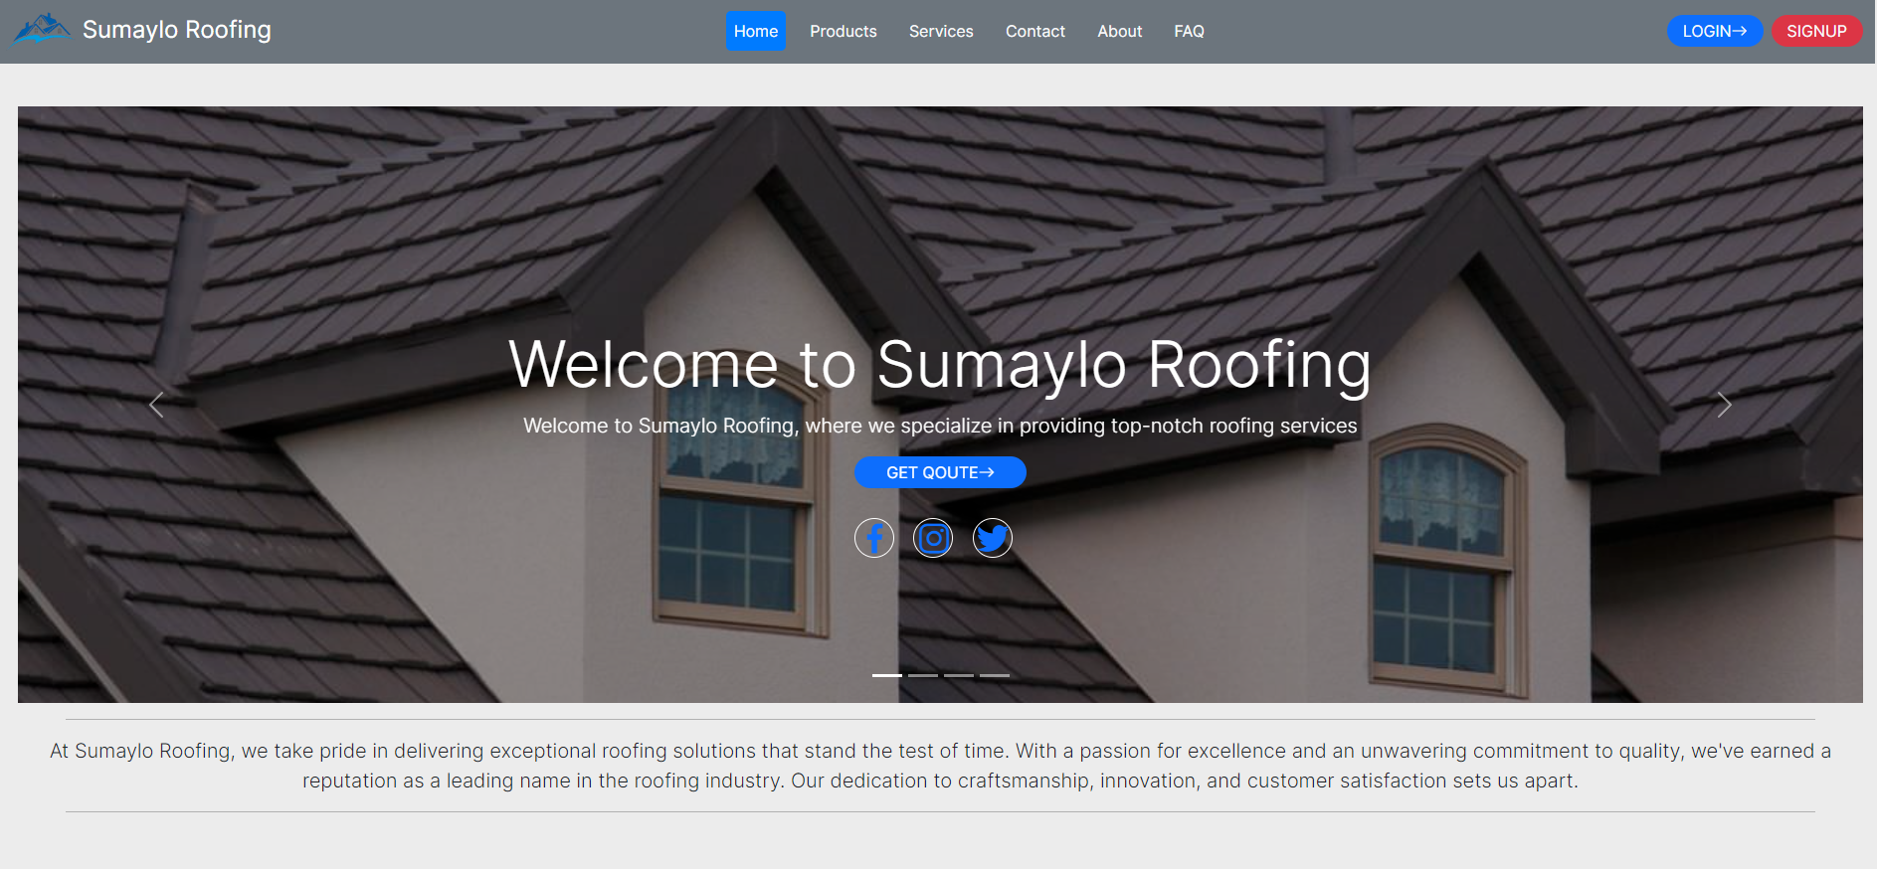
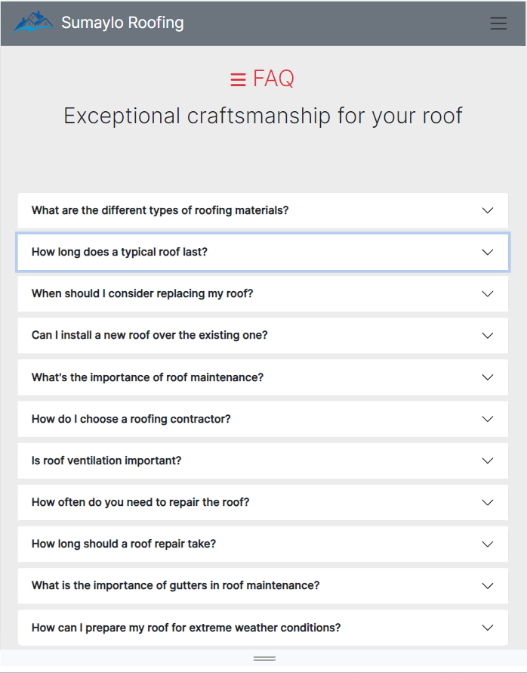
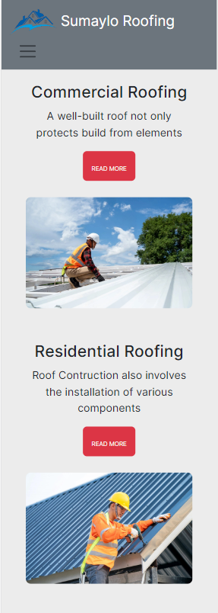
Resposiveness

Slide 9
Thank You!
GOD BLESS EVERYONE..

